Slide 1
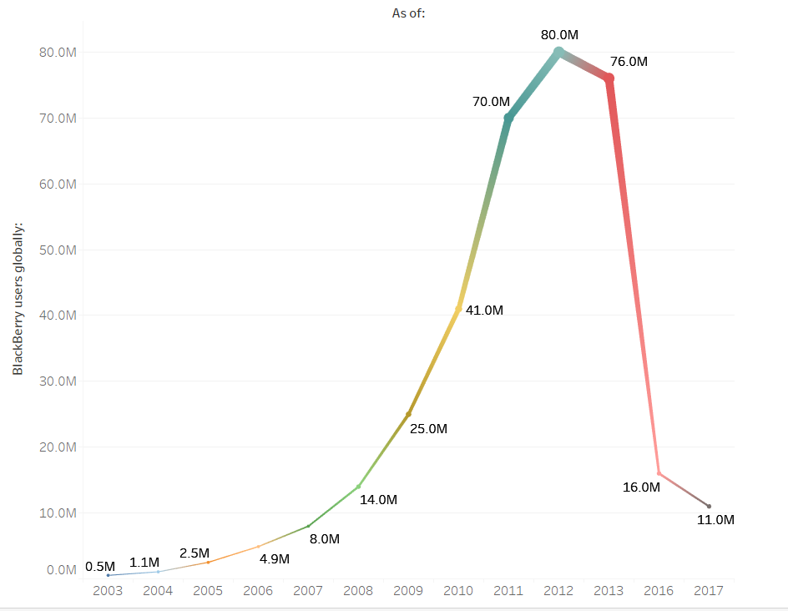
Preliminary Analysis - I
Blackberry Users over Time
Understand first things first.
Maneuver current product inventory
Create long-run development a priority
Embracing and learning lessons from past failure

Slide 2
Preliminary Analysis - II
Develop a strategic promotion and align it with sales
Align marketing with sales
Attract visionary product-creation relationships
Having developer support is crucial for staying on top of the game
Partner with visionary innovators
Create an iconic product
Innovation is key to be a top innovator

Slide 3
Preliminary Analysis - III
Operate profitably
Understand what drives profit with a laser focus
Being a leader in profit is necessary
Continue to focus and promote security
Blackberry is thought for its security; however, the message has been diluted.
IoT devices offer huge opportunity across many industries
Manage your reputation
The key is to create positive images.
Optimize its brand to manage its reputation
Leveraging the news media for good publicity

